Slide 1





AUDIT
TAXES
CONSULTING
2026

Slide 2


WHO ARE WE?
We are a multidisciplinary firm of accountants, auditors, attorneys, and economists with more than 25 years of experience in a wide range of professional services in auditing, consulting, and taxation.
Our strong commitment to our clients and the confidence that comes from having the support of a multidisciplinary team enable us to provide high-quality services as a firm.
MEMBER FIRM OF
GENEVA GROUP INTERNATIONAL
Geneva Group International (GGI) is a global alliance of independent professional firms that provides audit, accounting, tax, legal, and consulting services.
We operate in more than 870 offices across 126 countries, with approximately 623 partners worldwide and a staff of 29,600 employees, delivering services that meet international quality standards and provide personalized attention.
At GGI, we share knowledge, methodologies, and values, demonstrating a strong commitment to solving our clients’ problems, improving their business, advancing their goals, and exceeding their expectations.
PARTNER FIRM OF TPC GROUP
TPC Group is a global transfer pricing and valuation consulting firm with a presence in 20 countries, nominated by the Leaders League rating agency as an “Excellent Firm” 2025 in Transfer Pricing and recognized by World TP as a leading firm in the countries where we operate.
02

Slide 3

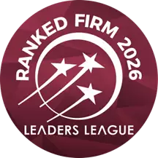

INTERNATIONAL RECOGNITION
Leaders League, a French rating agency, has recognized VAG Global in its 2026 Ranking as one of the best consulting firms, placing it in the “Highly Recommended” category under the “Auditors and Financial Advisors” section.
You can view the ranking at the following link: https://www.leadersleague.com/en/rankings/consulting-services-financial-and-administration-auditors-and-financial-advisors-auditing-and-accounting-firms-peru-2026
At VAG Global, we reaffirm our commitment to the highest standards of professional quality through our membership in the Forum of Firms, an international association that brings together networks of audit firms promoting consistent, high-quality global practices in cross-border auditing.
Being part of this prestigious organization, supported by the International Federation of Accountants (IFAC), ensures that our methodologies, processes, and quality reviews are aligned with international auditing standards and professional ethics.
03

Slide 4












OUR SERVICES
Tax
Item 5
20%
Item 1
20%
Pricing for
Transfer Pricing
Audit
Consulting
Item 4
20%
Item 2
20%
Outsourcing
Item 3
20%
04

Slide 5
AUDIT
No two audits are ever the same. Although the methodologies used by audit firms are similar, we believe that what sets our firm apart is the quality and direction of our service, the experience, dedication, and leadership of the professionals involved, the team’s ability to provide recommendations that add value to the business, and our commitment to effective communication and timely responses to client needs.
We firmly believe that our professional team has the industry experience, skill, and commitment to make this difference in our services:
1
Financial Audit
2
Management Audit
3
Internal Audit
4
Operational Audit
5
Compilation of Financial Statements
6
Engagements to Perform Agreed-Upon Procedures
7
Process Efficiency
8
Implementation of International Financial Reporting Standards (IFRS)
9
Review of Financial Statements
10
Sustainability and Climate Change
05

Slide 6

TAX AND LEGAL
We provide ongoing assistance and support in tax matters to help companies reach their growth potential both nationally and internationally. Our various services are tailored to the client’s business model in accordance with their business objectives.
We specialize in a variety of areas, which allows us to provide ongoing legal support on critical issues in today’s tax environment and to develop proactive global tax strategies.
The services we offer in the tax area are as follows:
1
Tax Audit
2
Beneficial Owner
3
Certification of Technical Assistance for Non-Residents
4
Local and International Tax Consulting
5
Tax Compliance
6
Tax Audits and Tax Defense
7
Tax Planning
06

Slide 7
OUTSOURCING
Our outsourcing service is designed to provide our clients with a comprehensive solution for operational, financial, and accounting matters, with the goal of complying with the accounting requirements established by law.
We offer the following services:
1
Accounting Outsourcing
2
Process Outsourcing
3
Payroll Outsourcing
07

Slide 8
Transfer Pricing
Companies that conduct transactions with related parties or are domiciled in tax havens must be able to provide tax authorities with Transfer Pricing documentation that proves and confirms that the relevant transactions are conducted on an arm’s-length basis.
We have international experience in Transfer Pricing, working in collaboration with our partner TPC Group, and can help organize the documentation to comply with local and international requirements.
We offer the following services:
1
Local File – Transfer Pricing Study (TTPS)
2
Master File
3
Country by Country Report
4
Strategic Planning
5
Intragroup Services – Benefit Test
08

Slide 9

CONSULTING
Our consulting services aim to help our clients achieve their business goals by offering effective solutions that combine innovation with industry-recognized best practices.
We offer the following services:
1
Valuation of companies, stocks, and intangible assets
2
Asset Management
3
Inventory Management
4
Capital Raising
5
Debt Restructuring
6
Valuation and Financial Modeling
7
Net Worth Valuation
09

Slide 10

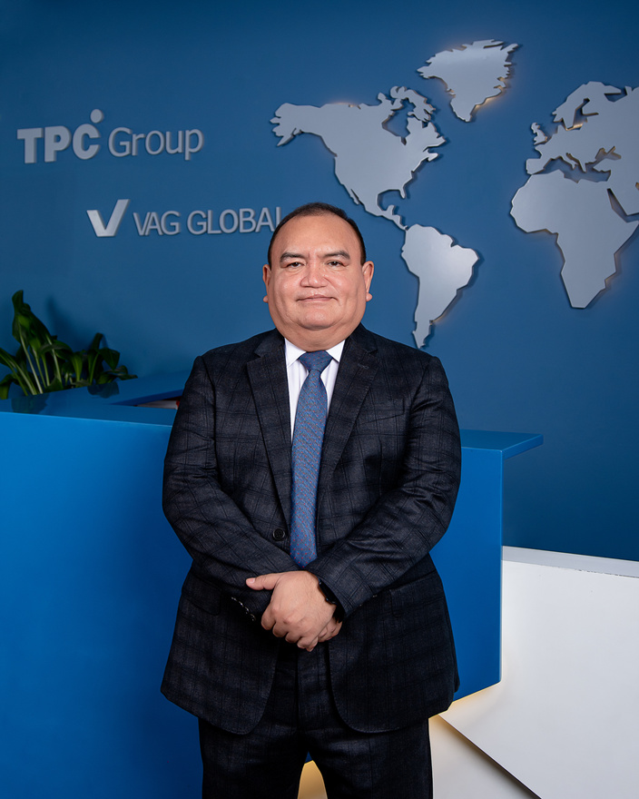

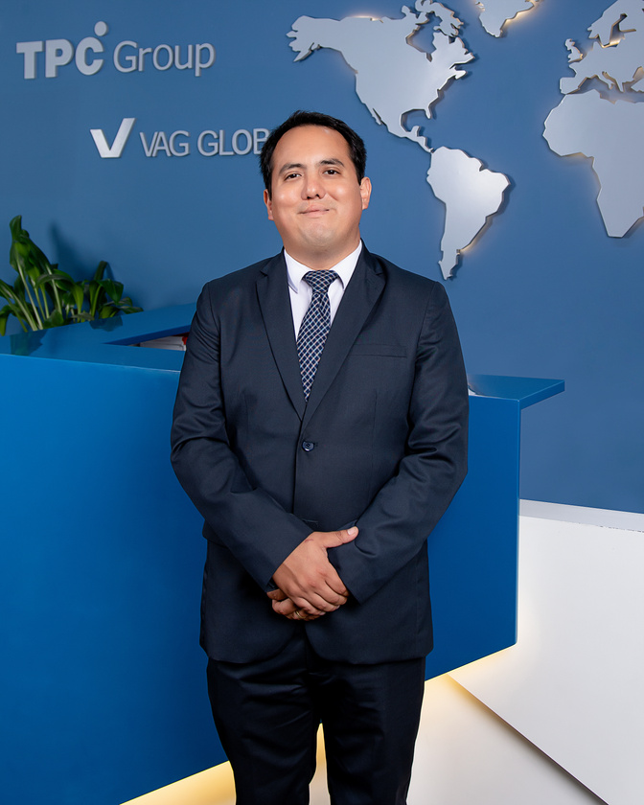
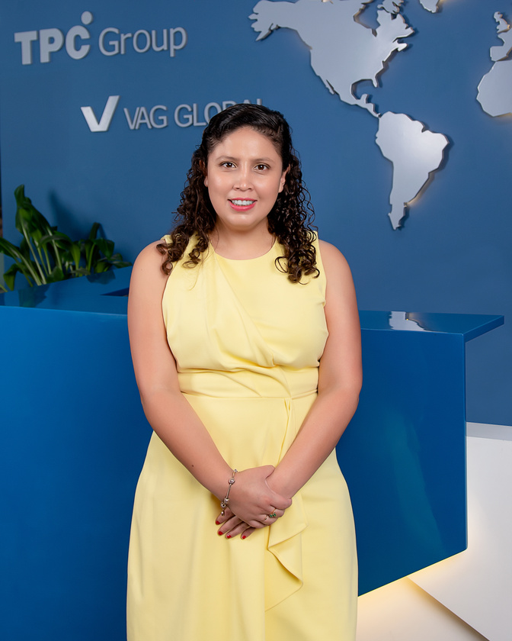
OUR TEAM
We are a multidisciplinary team of leading professionals in the field who, under the guidance of our Steering Committee, work diligently to meet our clients’ needs and assist them in complying with the formalities required by various regulatory agencies and the Tax Administration.
CARLOS VARGAS ALENCASTRE
Senior Partner
cvargas@vag-global.com
Certified Public Accountant licensed by the Lima Association of Certified Public Accountants, Independent Auditor, with a graduate degree in International Financial Reporting Standards (IFRS) from the University of Lima. With over 30 years of experience in auditing, accounting, and Transfer Pricing consulting both locally and internationally, as well as in the implementation of IFRS and double taxation avoidance agreements.
CARLOS EDUARDO VARGAS ARANGO
Partner
evargas@vag-global.com
Certified Public Accountant registered with the Lima Association of Certified Public Accountants and a graduate in Business Administration from the Peruvian University of Applied Sciences (UPC); Independent Auditor with a postgraduate degree in International Corporate Taxation from ESAN University and a postgraduate degree in Management Process Improvement and Redesign from the University of Lima. With over 14 years of experience in auditing, accounting, and Transfer Pricing consulting, both locally and internationally.
ABIGAIL ALAYO VILCARROMERO
Partner, Tax & Legal
aalayo@vag-global.com
Certified Public Accountant registered with the Lima Association of Certified Public Accountants and a graduate of the Peruvian University of Applied Sciences (UPC) with a postgraduate degree in Corporate Finance from CENTRUM Business School, Corporate Finance from the University of the Pacific, Mining Business Management from ESAN University, Tax Law from ESAN University, and a Specialized Postgraduate Degree in Transfer Pricing from CIAT. She is currently pursuing a Master’s degree in Tax and Business Law. She has over 10 years of experience in accounting, taxation, and legal matters.
10

Slide 11
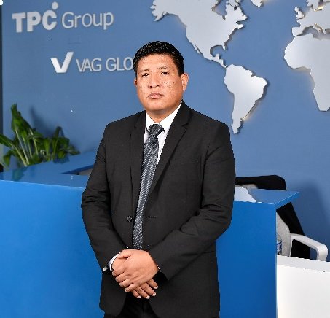
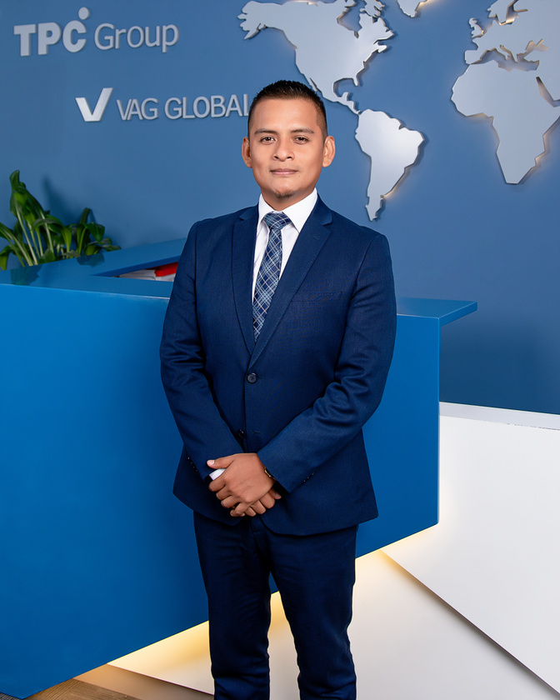
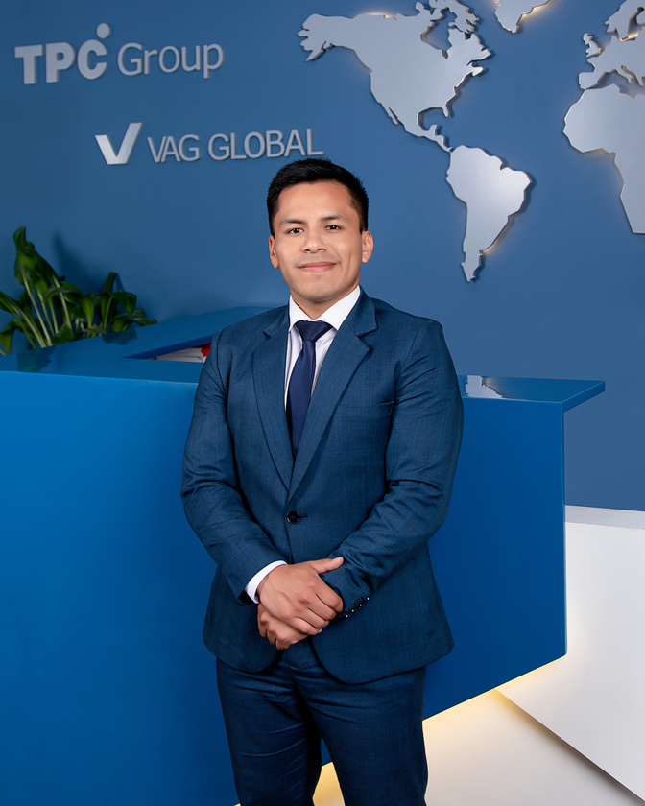
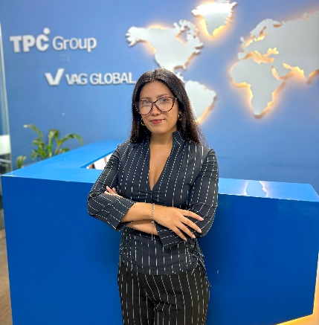
HECTOR LLANQUI
Audit Manager
hllanqui@vag-global.com
A certified public accountant and graduate of the National University of San Marcos, he is knowledgeable in International Financial Reporting Standards (IFRS). Additionally, his more than 12 years of professional experience in financial auditing focuses on the manufacturing, commercial, and general services sectors.
RODRIGO AYALA REYES
Accounting Manager
rayala@vag-global.com
A certified public accountant who graduated from the University of Sciences and Humanities, with a graduate degree in International Financial Reporting Standards (IFRS) and taxation from the same institution. He has over 14 years of experience in accounting and finance, with a focus on domestic, international, and multinational companies, as well as the implementation of accounting software for foreign companies.
GUSTAVO MARTINEZ GODOY
Tax Attorney
gustavo.martinez@vag-global.com
He holds a law degree from the National University of San Marcos (UNMSM). He has participated in various tax refresher courses organized by the Peruvian Institute of Tax Law (IPDT) and the Pontifical Catholic University of Peru (PUCP), and was a member of the winning team in the Second UNMSM Law Students’ Tax Competition. He has more than 5 years of experience in tax consulting and tax compliance. He is currently pursuing a Master’s degree in Tax Law at the University of Lima.
DANIELA RAMOS
Corporate Attorney
dramos@vag-global.com
She holds a law degree from the Peruvian University of Applied Sciences, with a specialization in Corporate Law and Economic Criminal Law. She has over three years of experience in company formation, immigration procedures, and comprehensive legal counsel for businesses. In addition, she has supplemented her education with specialized courses in Administrative Law. She is known for her analytical skills, commitment, and results-oriented approach, providing legal support for strategic decision-making and regulatory compliance.
11

Slide 12





























OUR MAIN CLIENTS
12

Slide 13








For further inquiries, please contact us
Lima Office
335 Manuel Olguín Ave., Suite 505
Link Tower Building
Santiago de Surco
Lima, Peru
+511 4364612
Santiago Office
1881 Nueva Providencia Ave., Suite 1414
Nuevo Centro Providencia Building
Santiago, Chile
+56 323 187 082
Bogotá Office
Cra. 16 #93A-16, Offices 203 and 204, Pasandú Building, Bogotá
+571 6015800236
contacto@vag-global.com
www.vag-global.com
2026

